Slide 1

Dehydration
Risk Awareness Tool (RAT)
Presented by:
The Virginia Department of Behavioral Health and Developmental Services
The Office of Integrated Health
Health Supports Network

Slide 2
Who benefits from this training
DSP's and caregivers- you will learn important risk factors associated with dehydration, learn to recognize signs and symptoms, and how to report and document.
Support Coordinators-you will learn important risk factors associated with dehydration, understand the signs and symptoms that DSP's and caregivers are going to recognize and provide in documentation, and learn diagnosis that may be associated with risk factors.

Slide 3
Objectives
1. Define dehydration.
2. State (4) signs and symptoms of dehydration.
3. Identify (3) causes of dehydration
4. State (3) risk factors for dehydration.
5. List one diagnostic test used by physicians to determine dehydration.
6. Identify (2) interventions used to correct dehydration.
7. List (2) complications caused by unidentified dehydration.
8. State (2) interventions to prevent dehydration.

Slide 4
Terms & Definitions
Electrolytes-are minerals in the body that have an electric
charge. They have many important jobs, including helping to
keep a balance of fluids in the body.
Hyponatremia - is a low sodium concentration in the blood.
UTI- refers to a urinary tract infection.

Slide 5

What is Dehydration?
Dehydration is condition caused by the loss of too much fluid from the body. It happens when loss of fluids is greater than fluids that are taken in, and the body does not have enough fluids to work properly.
There are 2 types of dehydration; water loss dehydration (hyperosmolar, due either to increased sodium or glucose) and salt and water loss dehydration (hyponatremia)(Rolands , 2019).

Slide 6
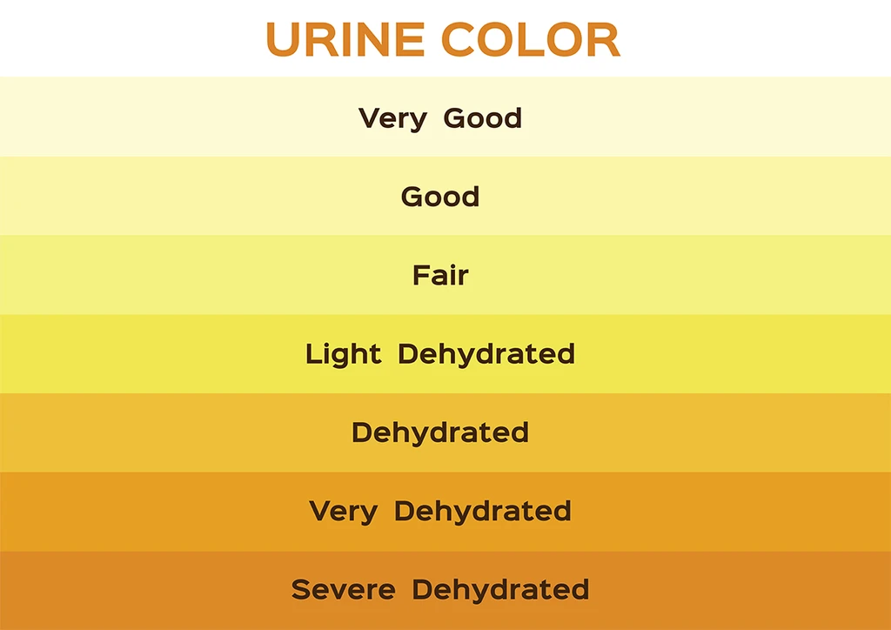
Signs and Symptoms
Feeling thirsty
Dry mouth, tongue or skin
Poor skin turgor
Muscle cramps
Constipation
Headache
Tiredness or lethargy
Irritability
Decreased urine output or
dark, concentrated urine
Dizziness or fainting
Sweating less than usual
Rapid heartbeat or breathing
Confusion or disorientation
Low blood pressure (orthostatic hypotension)

Slide 7
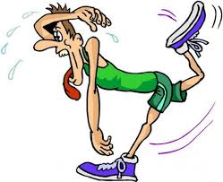
Causes of Dehydration
Diarrhea
Vomiting
Sweating too much
Fever
Not drinking enough
Urinating too much (Can be caused by certain medications and illnesses)

Slide 8
Diagnosis & Treatment
Diagnosis requires an evaluation of the Individual and laboratory testing, clinical assessment, and knowledge of the Individual’s medical history (Rolands, 2019).
How to treat...
Encourage to drink water or other hydrating beverages.
IV (intravenous) fluids should begin as soon as possible in a hospital or emergency care setting. IV fluids are usually a saline solution, made of water, sodium, and other electrolytes. By receiving fluids through an IV rather than by drinking them, the body can absorb them more quickly and recover faster (Thomas, et al., 2008).
Treating severe dehydration usually requires more than providing water or other beverages.

Slide 9
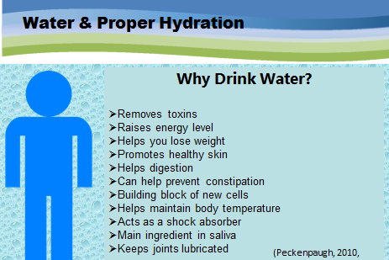

Slide 10

Importance of reporting change
Many individuals with intellectual are at risk for dehydration due to being unable to verbalize thirst, being immobile and unable to get a drink when desired and being reliant on others to provide hydration. According to a literature study completed in 2019 , the prevalence of dehydration ranged from 44%-75% for people suffering with difficulty swallowing (dysphagia) (Reber et al, 2019).
Although thickening liquids may address the dysphagia issue, thickening agents decrease desire for drinking due to texture and coating in mouth. Individuals with orders for thickened liquids should be monitored to ensure they are receiving adequate hydration (Reber et al., 2019)
Any changes or recognition that an individual has signs and symptoms on dehydration should be reported immediately. The individual should be taken to their PCP or an Urgent Care if issue is found on a weekend. Document your findings in daily note and who it was reported to.

Slide 11
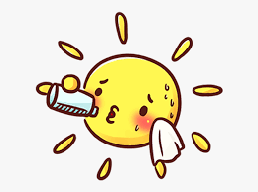
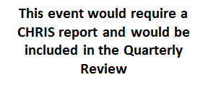
DSP's connect the dots....
Situation:
Sam is attending summer camp. The weather has been wonderful, 80 degrees all week. Sam is so excited that he doesn’t like to stop and eat or drink. Sam refuses to wear his hat while participating in the activities. In the afternoon Sam verbalizes that he feels funny. Sam's breathing becomes more rapid and he stops participating. Sam verbalizes he is thirsty and is offered water. Staff notifies the camp nurse.
Example only: follow your agency documentation standards.
Example of a daily note:
04/13/20 Sam attended summer camp today. Staff encouraged Sam to wear a hat due to the weather, but he refused. Staff encouraged Sam to drink water throughout the day, but Sam refused. Sam ate only 25% of his lunch. At 1:30pm that he felt funny and staff observed him sitting and not participating in the group activities. Staff observed Sam breathing fast. Sam reported he was thirsty and was given water. Staff reported observations to camp nurse.
Way to go DSP, you recognized a change!

Slide 12
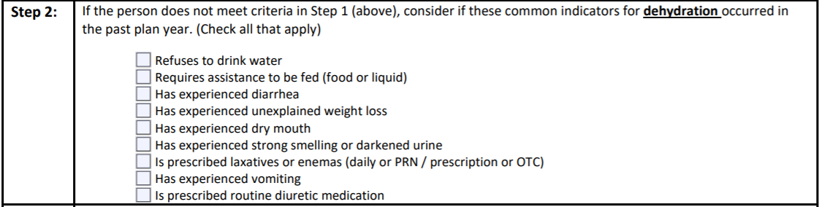
DSP's connect the dots....
Use the RAT tool to help staff be aware of risks and also prompt changes that need to occue with plans and support instructions. The RAT can help providers be proactive.
You are the boots on the ground! Based on your daily observations you may recognize a change in statue that would require evaluation. If you notice any of the risk factors listed below for dehydration, report and document it quickly.

Slide 13
Case Study
Jane lives in a group home with three other individuals. She enjoys going out into the community and loves to eat out. Jane is diagnosed with moderate intellectual disability, Seizures, and Paranoid Schizophrenia. Jane also has frequent urinary tract infections due to becoming dehydration. Jane's urologist has ordered that she consume at least 2000ml daily to help produce frequent urination. This requires staff to prompt and encourage throughout the day. Although Jane likes to be social, sometimes the paranoia keeps her from participating fully in activities. She has auditory hallucinations which make her fearful of others.
Jane becomes fearful of food and drink at times. Fearing that staff have not washed their hands when preparing, she will refuse to eat or drink. Jane likes food that is individually wrapped. If she finds spots on the utensils at mealtimes she will refuse to eat or drink. Jane enjoys drinking tea and coffee; however caffeine increases her seizure activity.

Slide 14
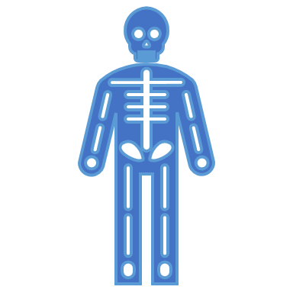
Apply what you learned
State (3) ways you could help Jane meet or exceed her daily recommendation for fluid intake and help her avoid becoming dehydrated.
1.__________________________
2.__________________________
3.__________________________

Slide 15
Connect the dots with the RAT Tool...
SC's- as you are completing the RAT tool keep in mind there are key diagnoses and situations you need to incorporate in discussion with providers and caregivers to ensure risk factors are being recognized.
Individuals who have fluid restrictions (Polydipsia).
Individual's that receive their nutrition and fluids through a gastrostomy tube.
Individuals who are unable to control their body temperature.
Individuals who do not sweat or sweat excessively.
Individuals with behaviors that have decrease access to water.
RAT TOOL
Individuals who receive thickened liquids or refuse to drink liquids.
Older Individuals that have lost their thirst perception.
Individual's with Dementia who forget to drink fluids.

Slide 16
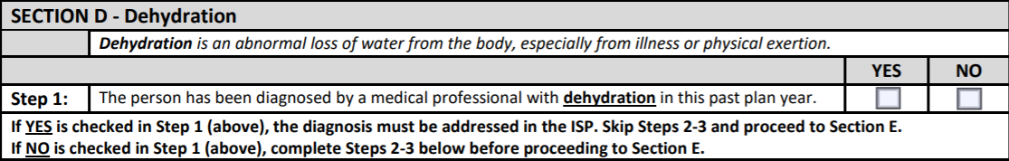
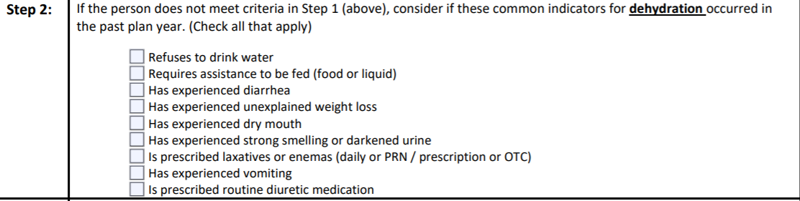
Follow these steps to success…
Prior to ISP meeting, review discharge summaries, medical reports, and health history for information.
Remember! Think about all settings: home, Day Support, Community Engagement
Skip Step 2 and go to Section E

Slide 17
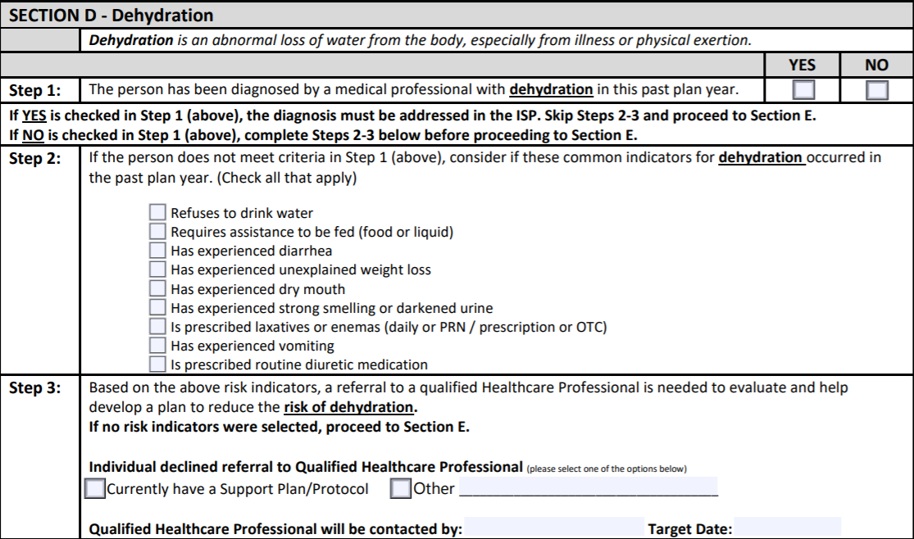
Follow these steps to success…
During the ISP meeting ask all participants if they are aware of any risk factors listed in Step 2
Dr. Hopewell
Nov 15, 20

Slide 18
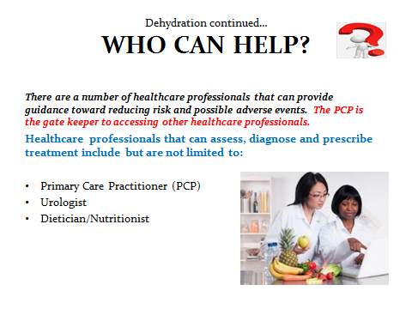

Slide 19
References
Benelam, B., & Wyness, L. (2010). Hydration and health: a review. Nutrition Bulletin, 35(1), 3–25. https://doi.org/10.1111/j.1467-3010.2009.01795.x
Chadwick, D. D., Jolliffe, J., Goldbart, J., & Burton, M. H. (2005). Barriers to Caregiver Compliance with Eating and Drinking Recommendations for Adults with Intellectual Disabilities and Dysphagia. Wiley Online Library. https://onlinelibrary.wiley.com/doi/abs/10.1111/j.1468-3148.2005.00250.x.
Kunst, K., & University of North Carolina. (March, 2020). The Fatal Four in IDD: Dehydration Signs and Risk Factors. Retrieved from https://www.relias.com/blog/the-fatal-four-how-dangerous-is-dehydration
Mayo Clinic. (2016). Dehydration can lead to serious complications. Retrieved from https://newsnetwork.mayoclinic.org/discussion/dehydration-can-lead-to-serious-complications/
Medline Plus. (2019). Dehydration. Retrieved from https://medlineplus.gov/dehydration.html

Slide 20
References
Reber, E., Gomes, F., Dahn, I., Vasiloglou, M., & Stanga, Z. (2019). Management of dehydration in persons suffering swallowing difficulties. J Clin Med 8(11), 1923. doi: 10.3390/jcm8111923.
Rolands, J. (2019, November). Severe Dehydration: Symptoms, Causes & Treatment. Retrieved from https://www.healthline.com/health/severe-dehydration
Thomas, D. R., Cote, T. R., Lawhorne, L., Levenson, S. A., Rubenstein, L. Z., Smith, D. A., … Morley, J. E. (2008). Understanding Clinical Dehydration and Its Treatment. Journal of the American Medical Directors Association, 9(5), 292–301. doi: 10.1016/j.jamda.2008.03.006
Peckenpaugh, N. (2010). Nutrition Essentials and Diet Therapy. Saunders, St. Louis, Mossouri.

