Slide 1

Pressure Injury
Risk Awareness Training (RAT)
Presented by:
The Virginia Department of Behavioral Health and Developmental Services
The Office of Integrated Health
Health Supports Network

Slide 2
Who benefits from this training?
DSP's and caregivers- you will learn important risk factors associated with pressure injuries, learn to recognize signs and symptoms, and the importance of reporting.
Support Coordinators-you will learn important risk factors associated with pressure injuries, understand the signs and symptoms that DSP's and caregivers are going to recognize and provide in documentation, and learn diagnosis that may be associated with risk factors.

Slide 3
Objectives
1. Define Pressure Injury
2. Identify (3) risk factors for pressure injuries.
3. State (4) signs/symptoms of a pressure injury.
4. Identify the importance of changes in skin.
5. State (4) treatments for pressure injury.
6. List (4) prevention strategies for pressure injuries.
7. Identify (2) professional sources for help with pressure injuries.

Slide 4
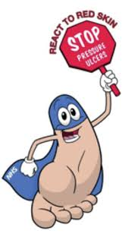
What is a pressure injury?
A pressure injury to the skin is a result of constant
pressure due to impaired mobility. The pressure
results in reduced blood flow and eventually causes cell
death, skin breakdown, and the development of and open
wound.
Pressure injury can occur in persons who are wheelchair
bound or bed-bound, sometimes even after a
short time (2 to 6 hours). If the conditions leading to the
pressure injury are not rapidly corrected, the localized skin
damage will spread to deeper tissue layers affecting muscle,
tendon, and bone.
Common sites include the sacrum (tailbone), back,
buttocks, heels, back of the head, and elbows. If not
adequately treated, open ulcers can become a source of
pain, disability, and infection.
(Zeller, Lynm, & Glass, 2006)

Slide 5
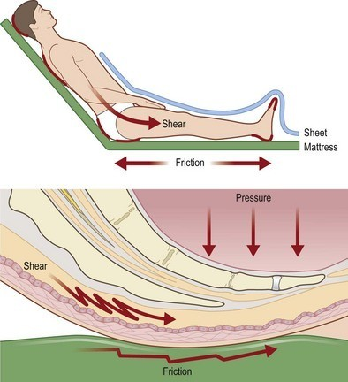
Risk factors for pressure injury
Shearing and friction
Moisture
Decreased movement
Decreased sensation
Circulatory problems
Poor nutrition
Age
(Harvard Health Publishing,2020)
Notes:
Friction or shear (As a result of being moved across bed sheets or when the head of a person’s bed is elevated that causes the torso to slide downward (Mayo Clinic, 2020)
Shearing and friction — Shearing and friction causes skin to stretch and blood vessels to kink, which can impair blood circulation in the skin. In a person confined to bed, shearing and friction occurs each time a person slides across the bed sheets.
Moisture — Wetness from perspiration, urine or feces makes skin under pressure more likely to suffer injury. People who can't control their bladders or bowels (people who are incontinent) are at high risk of developing bedsores.
Decreased movement — Bedsores are common in people who can't lift themselves off the bed sheets or roll from side to side. Without these small movements throughout the day, skin that is pressing against the bed does not get a steady supply of oxygen and nutrients. Blood flow is inadequate in these parts of the skin. (People who can move without assistance have a lower risk of bedsores because they can shift their weight periodically.)
Decreased sensation — Bedsores are common in people who have nerve problems that decrease their ability to feel pain or discomfort. Without these feelings, the person cannot feel the effects of prolonged pressure on the skin.
Circulatory problems — People with atherosclerosis, circulatory problems from long-term diabetes or localized swelling (edema) may be more likely to develop bedsores. This is because the blood flow in their skin is weak, even before pressure is applied to the skin.
Poor nutrition —Bedsores are more likely to develop in people who don't get enough protein, vitamins and minerals.
Age — Elderly people, especially those over 85, are more likely to develop bedsores because skin usually becomes more fragile with age.
(Harvard Health Publishing)
Evidence indicates that urinary incontinence increases the risk of pressure injury in individuals (Gray and Giuliano, 2018). Additionally, moisture on the skin from sweat can increase a risk for pressure injury. Research indicates that moisture between skin and fabrics can place a person at a higher risk of pressure injury development (Schwartz, Magen, Levy and Gefen, 2018).

Slide 6
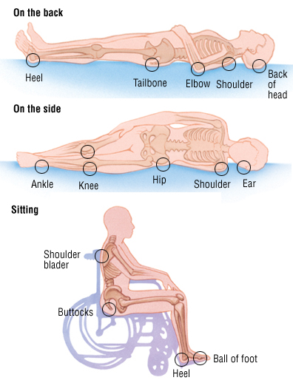
Common sites of Pressure Injury
Any part of the body can develop pressure injuries, but most at risk are parts overlying a bony prominence.

Slide 7
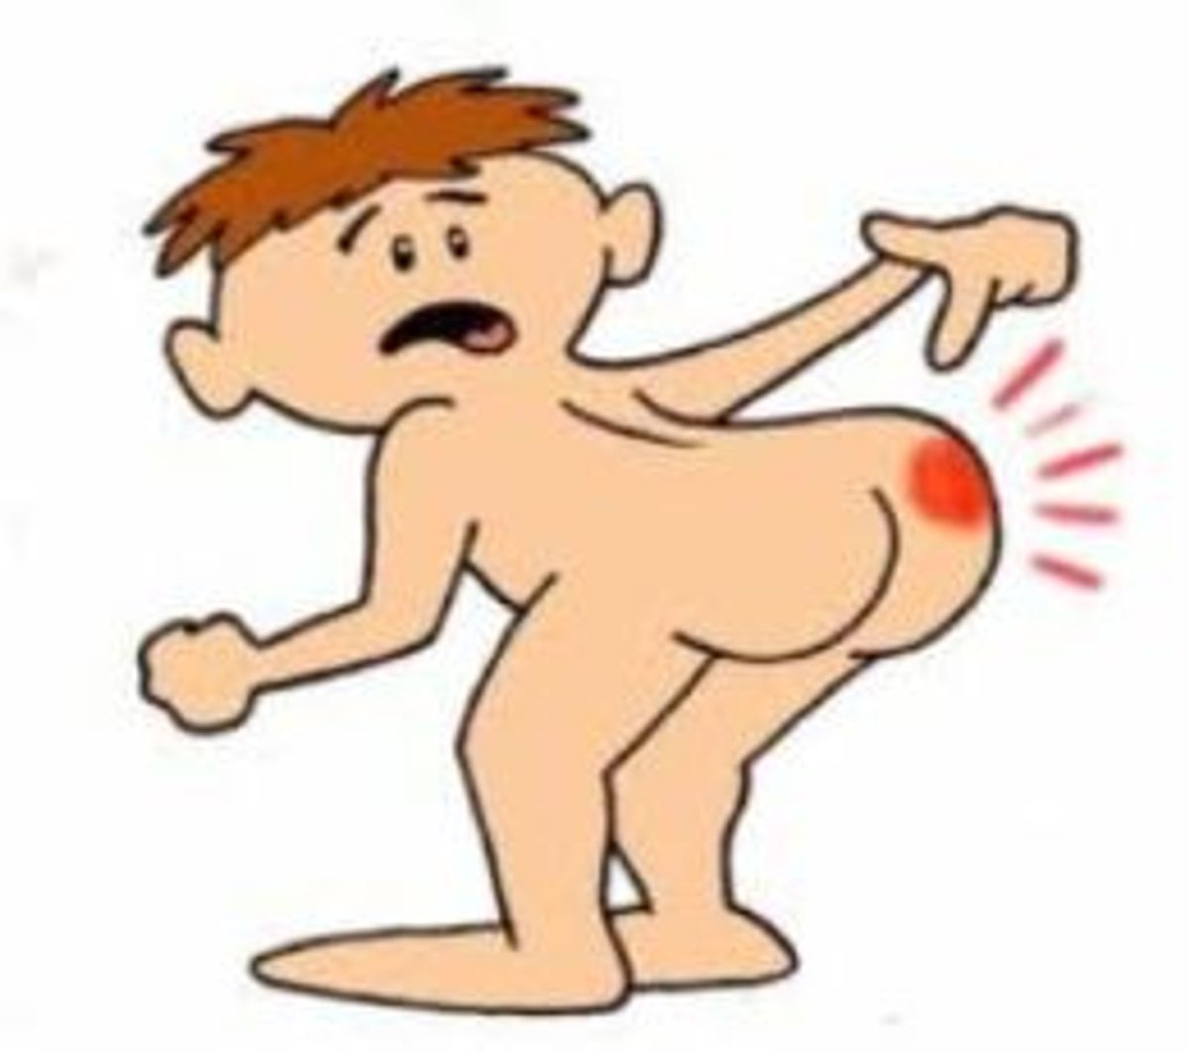
Signs and Symptoms of a pressure injury
Unusual changes in skin color or texture
Swelling
Pus-like draining
An area of skin that feels cooler or warmer to the touch than other areas
Tender areas
(Mayo Clinic, 2020)
Changes in skin appearance should always be reported to a physician as soon as possible.

Slide 8
How pressure injuries are diagnosed ?
Pressure injury identification is supported by a variety of assessment tools. These tools include skin visualization techniques and risk assessment tools (Borzdynski, McGuiness and Miller, 2015).
The Braden Scale for Predicting Pressure Ulcer Risk, is a tool that was developed in 1987 by Barbara Braden and Nancy Bergstrom. The purpose of the scale is to help health professionals, especially nurses, assess a patient's risk of developing a pressure ulcer.
The Norton risk-assessment scale which was published in 1962 as the first mean of evaluating pressure ulcers risk. The scale is used in the evaluation of pressure injury risk based on factors such as mobility or physical condition.
Healthcare professionals who can stage a PI include physicians, nurses and board-certified wound specialists. (Board certified wound specials arehealthcare professionals who have received additional training and education in order to set for a national board certification examination. (American Board of Wound Management, 2019).
Notes:
Pressure injuries are identified through a staging process where the injury is described and classified based on the extent of tissue damage (Edsberg et al, 2016).

Slide 9
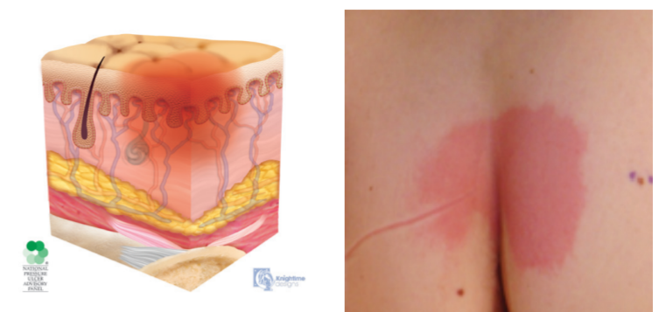
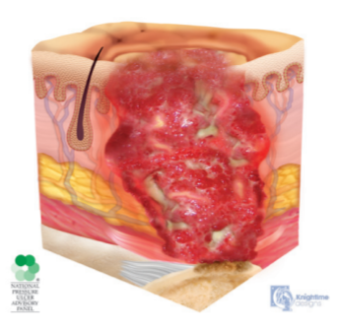
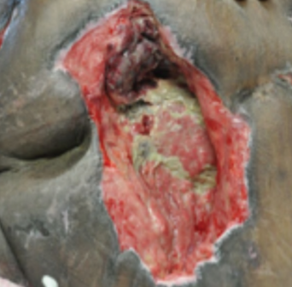
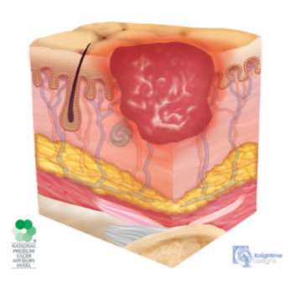
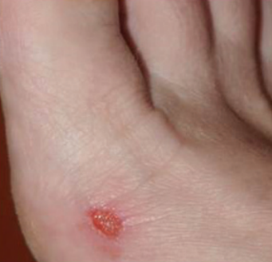
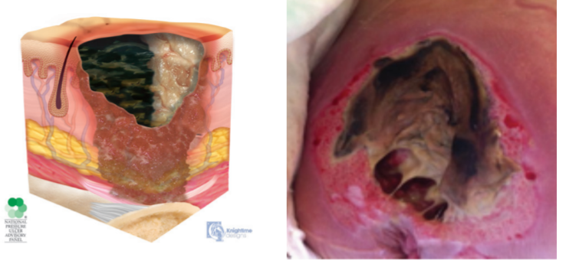
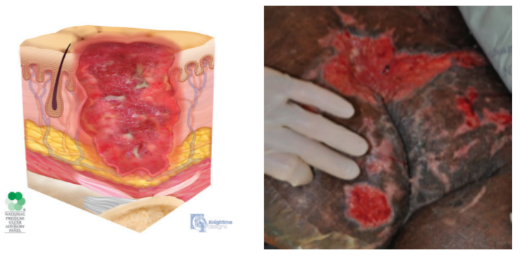
Pressure Injury Stages
Stage 1: Skin is intact but red.
Stage 4: Skin is broken, muscle or bone may be visible.
Stage 2: Skin is broken but there is no depth to the wound.
Unstageable: Severe tissue loss is noted, wound may appear as empty hole.
Stage 3: Skin is broken but there is obvious depth to the wound, fat tissue may be noted.
Images by National Pressure Injury Advisory Council, 2019
Notes:
Once identification of a pressure injury has occurred, the next step is commonly called ‘staging’. Staging is when a healthcare professional (physician, nurse, certified wound specialist) examines the skin at and around the site of the injury. The healthcare provider will then determine, based on the criteria listed below, the severity of the injury (National Pressure Injury Advisory Panel, 2019).
Matching Activity Handout

Slide 10

Importance of reporting change
Many individuals with intellectual and developmental disabilities cannot report discomfort or pain. Being unable to reposition oneself or unable to ambulate is a risk factor for pressure injury. Evidence suggests non-verbal individuals are at a higher risk for under-treatment of pain. Identifying an individual is experiencing pain and treating it improves daily living, their ability to participate in enjoyed activities, and increases risk of depression (Lewis, 2011). Pain is a key sign of the presence of a pressure injury (McGinnis et al., 2014)
Any changes noted in color, temperature, or presence of skin breakdown should be reported immediately. To report a change contact the nurse. If nursing is not available, the individual should be taken to their PCP or an Urgent Care if issue is found on a weekend. Delay in seeking care can result in further injury and breakdown.

Slide 11

DSP's connect the dots...
Situation: Jessie reports to DS with a new pair of shoes. Today DS is goind to the dog park to put out liter bags. After the group returns at the end of the day, you notice that Jessie is frowning and limping. You ask her if something is wrong and she points to the new shoes. Jessie has diabetes.
Example only: follow your agency documentation standards.
Way to go DSP! You recognized a changed.
Example of a daily note: 4/16/20 3:00pm Returned to the DS center after an outing to refill the dog bags. Noticed that Jessie was not happy, she was frowning almost ready to cry. She indicated that her new shoes were hurting her feet. You assist her to take off her shoes, she had a large blister on the great toe of both feet, and a blister on both heels. DSP notified the DS manager.

Slide 12
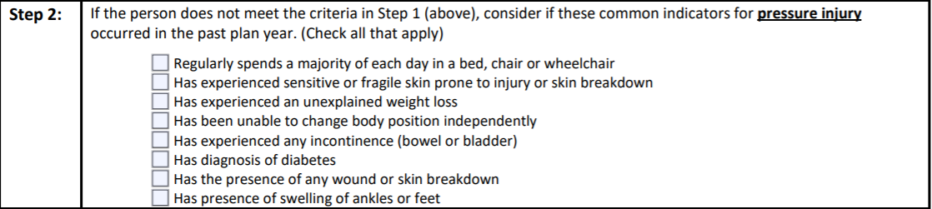
DSP's connect the dots...
You are the boots on the ground. Based on your daily observations you may recognize a change in status that would require evaluation. If you notice any of the risk factors listed for pressure injuries, report and document them quickly.
Use the RAT tool to help staff recognize risks and prompt changes that need to occur with plans and support instructions. The RAT can assist providers to be proactive.

Slide 13

Treatments for Pressure injury
Treatment begins with a physician and possible referral to a wound specialist. Each situation will be assessed individualized strategies implemented.
Identify the source of pressure. Minimize pressure by utilizing wedges, frequent turning, and repositioning ever 2 hours.
Minimize shear and friction to reduce the damage to tissue.
Control moisture-skin should be kept clean and dry.
Pain management-pressure injuries are painful and may require oral medication for pain, especially around treatment times.
Barrier ointments should be used after incontinence episodes to protect skin.
Wound care may be required based on severity. Training for the nurse and staff on care in between appointments will be provided.
Notes:
Instructor: If changes in skin color seem to be due to contact with a surface such as the bed, wheelchair, or chair, then relieve the pressure by using pillows or wedges to raise the extremity.
Never pull an individual across a surfact, this "drag" causes skin damage. See slide on friction and shearing.
Control moisture- do not wait to change someone who is incontinent. Moisture causes the skin to soften, swell, and wrinkle. Ammonia and enzymes in urine and feces cause breakdown in the skin's protective ability.
Pain associated with pressure injuries is often described as constant, burning sensation, especially during turning,repositioning and dressing changes. Studies have shown that many people to do receive any pain medication prior to activies such as dressing changes.
Barrier ointments-form a protective layer over skin from irritants such as urine and feces. BO help protect skin from excessive moisture (Urine and sweat).
Wound Care treatment- there are many products available that may be utilized to treat a pressure injury. This depends on the extent of damage and how much drainage is present in the healing bed.

Slide 14

Prevention Strategies are critical!
Positioning- shifting weight at least every 2 hours
Specialty equipment- air and foam mattresses are available to redistribute weight, standers, specialized wheelchair with pressure relieving cushion.
Pillows-can assist in shifting weight and taking pressure off boney prominences.
Wedges- help with turning and repositioning and keeping boney areas off surfaces.
Keep skin clean and dry- washing the area with a product approved by the PCP or wound care. Skin should be free from urine, stool, and sweat.
Skin protectants-barrier creams and ointments help prevent breakdown in skin folds, perineum, and sacral areas. They protect skin from the corrosive nature of urine and feces.
Protocols- written by medical professionals for staff to follow to address positioning, use of DME equipment, and skin treatments.

Slide 15
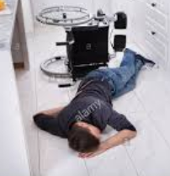
Case Study- Meet John

Slide 16
Case Study
John is a friendly and fun-loving guy. He is diagnosed with Cerebral Palsy, GERD, Diabetes insulin dependent, and chronic constipation. He is verbal and has a good sense of humor. He really loves going to his day program. John has slow movements and requires assistance to stand and pivot. If lying in the bed he can roll from side to side using the bed rails. When John becomes upset, he will wiggle out of his wheelchair onto the floor when staff are not looking. On the floor he refuses to let the staff help him back into his wheelchair. John has a behavior plan that states steps staff are to follow in the event John refuses to accept help. Today, John became very agitated when he could not go to his day program. John wiggled out of his wheelchair onto the floor. Staff tried to get him up, but he would slap at them and try to spit in their face. Finally, the staff gave up and told John to let them know when he was ready to get back in his chair.
John sat in the floor for 3 hours. Finally, he asked for help and staff put him in on the bed. HIs clothes were wet due to incontinence. As staff provided hygiene and put on dry clothes, they noticed that John had two areas of red skin: one on his right cheek and the other on his left knee.

Slide 17
Apply what you've learned
Name three interventions that could have prevented John from developing pressure injury:
1.___________________________
2.___________________________
3.___________________________

Slide 18
SC's connect the dots...
SC's- as you are completing the RAT tool keep in mind there are key diagnoses and situations you need to incorporate in discussion with providers and caregivers to ensure risk factors are being recognized.
Incontinent of Urine and/or stool
(wears briefs)
Requires DME for mobility​
Spends 4.5hours or more a day in wheelchair ​
Fragile skin
Edema related to Congestive
Heart Failure, and /or Peripheral Artery
Disease.​
Edema related to Congestive Heart Failure, Peripheral Artery Disease.
RAT TOOL
Recent change in weight
loss or gain​
Obesity Anorexia
(Prader Willi's) ​
Unable to change body position.​
(Cerebral Palsy, Stroke)​
Behavior plan in place addressing putting self in risky situations (Refusing help off floor)

Slide 19
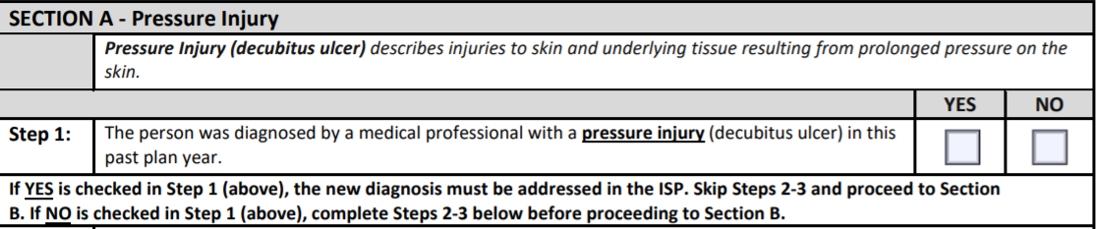
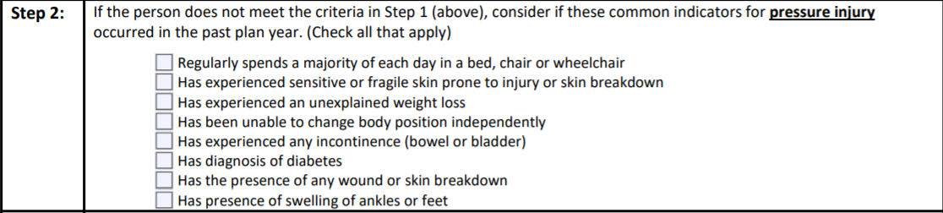
Prior to ISP meeting, review discharge summaries, medical reports, and health history for information.
Follow these steps to success…
Remember! Think about all settings: home, Day Support, Community Engagement
Skip Step 2 and go to Section B

Slide 20
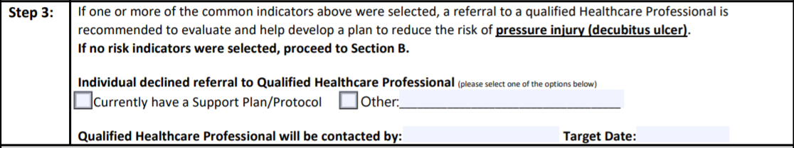
Follow these steps to success…
During the ISP meeting ask all participants if they are aware of any risk factors listed in Step 2
Dr. Hopewell
Nov 15, 20

Slide 21

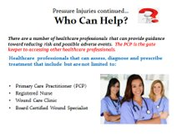

Slide 22
References
American Board of Wound Management (2019). Board certification.
Retrieved from http://www.abwmcertified.org/abwm-certified/board-certification/
Borzdynski, C.J., McGuiness, W., and Miller C. (2015). Comparing visual and objective skin assessment with
pressure injury risk. International Wound Journal.
Retrieved from https://www.researchgate.net/profile/Caroline_Borzdynski/publication/280119914_Comparing
visual_and_objective_skin_assessment_with_pressure_injury_risk/links/55bf26ba08aec0e5f445ecd3/Compar
ing-visual-and-objectiveskin-assessment-with-pressure-injury-risk.pdf
Edsberg, L.E., Black, J.M., Goldberg, M., McNichol, L., Moore, L. and Sieggreen, M. (2016). Revised national pressure ulcer advisory panel pressure injury staging system. Journal of Wound, Ostomy and Continence Nursing. 43(6). 585-597. DOI:10.1097/WON.0000000000000281
Gray, M. & Giuliano, K.K. (2018). Incontinence-associated dermatitis, characteristics and relationship to pressure injury: A
multisite epidemiologic analysis. Journal of Wound, Ostomy and Continence Nursing. 45(1). 63-67. DOI:
10.1097/WON.0000000000000390
Harvard Health Publishing. (n.d.). Bedsores (Decubitus Ulcers). Retrieved from https://www.health.harvard.edu/a_to_z/bedsores-decubitus-ulcers-a-to-z
Lewis, S., Dirksen, S., Heitkemper, M., Bucher, L., & Camera, I. (2011). Medical-surgical nursing: Assessment and management of clinical problems (8th edition). Pain (p.127-151). St. Louis, MO: Elsevier Mosby.
Mayo Clinic (2020). Bedsores (pressure ulcers). Retrieved from https://www.mayoclinic.org/diseases-conditions/bed-sores/symptoms-causes/syc-20355893
McGinnis, E., Briggs, M., Collinson, M., Wilson, L., Dealey, C., Brown, J., … Nixon, J. (2014). Pressure ulcer related pain in community populations: A prevalence survey. BMC Nursing, 13(16), 1-10. doi:10.1186/1472-6955-13-6
Schwartz, D., Magen, Y.K., Levy, A., and Gefen, A. (2018). Effects of humidity on skin friction against medical textiles as related to prevention of pressure injuries. International Wound Journal, 15(5). https://doi.org/10.1111/iwj.12937
Zeller, J. L., Lynm, C., & Glass, R. M. (2006). Pressure Ulcers. Jama, 296(8), 1020. doi: 10.1001/jama.296.8.1020

