Slide 1

Seizures
Risk Awareness Tool (RAT)
Presented by:
The Virginia Department of Behavioral Health and Developmental Services
The Office of Integrated Health
Health Supports Network

Slide 2
Who benefits from this training
DSP's and caregivers- you will learn important risk factors associated with seizures, learn to recognize signs and symptoms, and the importance of reporting.
Support Coordinators-you will learn important risk factors associated with seizures, understand the signs and symptoms that DSP's and caregivers are going to recognize and provide in documentation, and learn diagnosis that may be associated with risk factors.

Slide 3
Terms & Definitions
Generalized Seizures
Tonic-clonic seizures cause jerking or convulsive movements of the limbs or torso.
Absence seizures can cause a person to briefly stare off into space and/or have a lapse of awareness.
Focal Seizures - Affect only one area of the brain and are classified into three categories: simple focal; complex focal; or secondary generalized, which begin with a focal seizure & are then followed by a generalized seizure.
Preictal-signs or symptoms, perceived by the person and/or observed by caregiver, appearing up to 24 hours preceding seizure onset.
Postictal - Is an abnormal condition that lasts for a period of time that begins when a seizure subsides and ends when the person returns to baseline.

Slide 4
Objectives​
1. Define seizure.
2. List (3) signs and symptoms of a seizure
3. State (2) causes of seizures
4. Identify (3) complications of seizures.
5. State (3) caregiver recommendations.
6. Identify (2) medical professionals that can help with seizures.

Slide 5
What is a Seizure?​
A seizure is one of many neurologic conditions characterized by abnormal electrical brain activity. Epilepsy is a chronic seizure disorder with recurrent and/or random seizure activity (Devinsky, et al., 2015).
Types of Seizures- Many people with epilepsy have more than one type of seizure. Seizures are generally classified into two categories:
1) Generalized seizures
2) Focal seizures
(CDC, 2018)

Slide 6
Signs
Preictal
Postictal
Aura
A seizure may start with a simple or complex partial seizure known as an aura.
The person may experience:
Abnormal sensations such as a certain smells & taste .
Vertigo
Nausea
Anxiety
Déjà vu
Visual & Auditory Phenomena
(Dugan et al., 2014)
Confusion
Lethargy
Upset or embarrassed
No recall of the seizure, and other memory loss.
Abnormal or combative behavior.
Postictal coughing
Spitting
Hypersalivation
Nose-wiping
Psychosis, and mania
(Abood, 2019) (Scaramelli et al., 2009)

Slide 7

Symptoms
Symptoms vary from person to person.
Staring spells.
Violent shaking
Loss of alertness.
(CDC, 2018)
The type of seizure depends on the part of the brain that is affected.
Absence (petit mal) seizure characterized by staring into space or by subtle body movements, such as eye blinking or lip smacking. These seizures may occur in clusters and cause a brief loss of awareness.
Generalized tonic-clonic (grand mal) seizure involves the entire body, including aura, ,abrupt loss of consciousness, body stiffening (rigid muscles) and shaking, and sometimes loss of bladder control or biting your tongue.
Focal seizures result from abnormal electrical activity in one area of your brain. Focal seizures can occur with or without loss of consciousness (Mayo Clinic, 2019).

Slide 8

Seizure Triggers
Triggers are different for each person. Lack of sleep and stress can increase the risk of seizure activity. Missing doses of medication, stress, lack of sleep, and drug and alcohol use are common reasons for breakthrough seizures (Bonnett, Powell, Smith, & Marson, 2017).
Common triggers include:
Missed medications
Lack of sleep
Stress/Anxiety
Sickness or fever
Certain medications
Photosensitive (flashing lights)
Excessive noise
Hormonal changes (menstrual cycle)
Alcohol or drug use
Herbal supplements
Low blood sugar (NINDS, 2020)

Slide 9
Complications
Injury from falls, bumps, or self-inflicted bites
Medication side effects (drowsiness, and drug toxicity)
Permanent brain damage (stroke or other damage)
Longterm medication side effects (osteporosis)
Breathing in food or saliva into the lungs during a seizure, which can cause aspiration pneumonia
(NIH, 2020)

Slide 10

Diagnosing
The physician will need to know as much as possible about what happened immediately before, during, and after the seizure.
How often seizures occur, whether there are any warning signs, and symptoms present during the seizure.
Electroencephalography (EEG) is a simple and painless study that records the brain’s electrical activity picked up by tiny wires taped to the head. Specific brain wave patterns may be noted during or between seizures in people with epilepsy and may help with diagnosis.
Imaging studies to look at the brain may be helpful in locating tumors, scars, or other abnormalities that may be causing seizures.
Magnetic resonance imaging (MRI)
Computed tomography (CT)
These scans create pictures of the inside of the brain.
(Karceski, 2007)

Slide 11
Treatment of seizures
Medication is the first line of treatment for seizures. Treatment may require more than one medication for control. Determining the right medication and dosage can take time. The physician must consider other medications and diagnoses.
VNS-vagal nerve stimulators are attached to the vagus nerve in the neck. An electrical signal is sent to the brain at the onset of a seizure. A VNS can be used if the individual feels a seizure coming on or at the beginning of symptoms.
Surgery is used when medications are not effective. Surgeons locate and remove the area of the brain where the seizures originate.
Responsive Neurostimulation- is a device implanted on the surface of the brain or in brain tissue. The RN can detect seizure activity and delivers a electrical stimulation to stop seizure activity.
Dietary therapy- diets (Keto) that restrict the amount of carbohydrates consumed. There are variations of the Keto diet that are not as restrictive.
Deep brain stim- electrodes implanted within the brain sends impulses to help regulate brain activity.
(Mayo Clinic, 2019)

Slide 12

Importance of reporting change
Any change related to an individual's seizure activity should be reported. Seizures may occur without warning and in individuals that have never experienced one before. For new seizure activity, call 911.
Seizure protocols should be in place for individuals who have documented seizure disorders. A protocol will ensure staff are trained specifically to that individual and when calling 911 is necessary.
Document your findings in daily note and who it was reported to.
Be sure to follow up with the individual’s Primary Care Provider (PCP) or licensed healthcare provider (ex. Nurse or Physical Therapist) to discuss their risk for falls.

Slide 13

DSP's connect the dots…
Situation: Mary is normally at the center of attention. She participates in many activities during the day. Mary had a PCP appointment yesterday and was diagnosed with Sleep Apnea. Today, Mary is sitting at the end of the table. She is not acting as if she feels well, so you stay close because she has a history of seizures. She slumps over in her chair and starts jerking. You run to her side to support her. The seizure lasts for 30 seconds.
Example only: follow your agency documentation standards.
Example of a daily note: 4/16/20 11:00am Mary was working on an activity this morning when she slumped over in her chair having a seizure. DSP ran to her side to support her. Since she was sitting in her wheelchair, she remained there. The seizure lasted for 30 seconds. Mary's protocol was followed. DSP notified the DS manager.

Slide 14
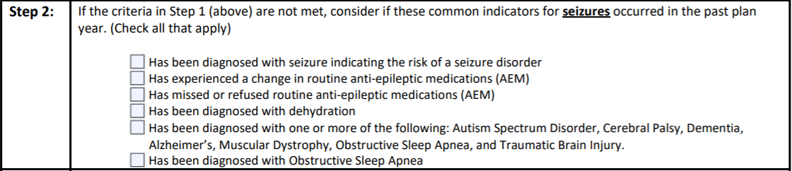
DSP's connect the dots...
Use the RAT tool to help staff recognize risk and prompt changes that need to occur within plans and support instructions. The RAT can help providers be proactive.
You are the boots on the ground! Based on your daily observations you may recognize a change in status that would prompt evaluation. If you notice any of the risk factors listed below for seizures, report and document it quickly.

Slide 15
Caregiver Recommendations
Consider the following questions as outlined during First/Aid CPR:
Is this the first seizure?
Is the person having difficulty breathing?
Is the person having difficulty recovering?
Did the person have another seizure soon after the first one?
Did the seizure last 5 minutes or longer?
Did the person sustain an injury during the seizure?
Does the person have diabetes, pregnant, heart condition?
Did the seizure take place near water?
Is the person elderly, could they have suffered a stroke?
For “YES” to any of these questions, initiate 911
Make note of the time the seizure started. Keep the person safe by ensuring the airway is open, monitoring breathing, protect the head to prevent injuries, roll onto side, loosen clothing from around neck, clear away objects that might cause harm, and administering emergency medications as directed and training allows. Do not put anything in the person’s mouth. Do not try to restrain the person. STAY WITH THE PERSON UNTIL EMS ARRIVES! (CDC, 2020)
REMEMBER: NOT BREATHING- Initiate 911 and start CPR

Slide 16
Megan is diagnosed with a seizure disorder. She has suffered with seizures since 6 months old. She attends her Neurologist appointments every 6 months. Along with medications twice daily, she has a VNS that is used when she exhibits signs of an oncoming seizures. The magnet is kept in her left pocket. Megan is being unusually quite today. That is usually a sign that she is not feeling well. One of the normal staff is out today, and the substitute DSP working is not familiar with Megan.
While eating breakfast, Megan starts to seize. The new DSP yells for help. Megan is falling out of her seat. The DSP is trying to get her to the floor.

Slide 17
Applied what you’ve learned
List (3) ways to support this individual during a seizure
1._______________________________
2. ______________________________
3._______________________________

Slide 18


SC's connect the dots...
Seizure Protocols?
Has frequent medication changes
Falls with head injury.
Diagnoses of diabetes –has frequent low BS levels
Any implanted devices?
RAT TOOL
Refuses to take medications at times
Becomes overheated easily when outside
Has history of electrolyte imbalances

Slide 19
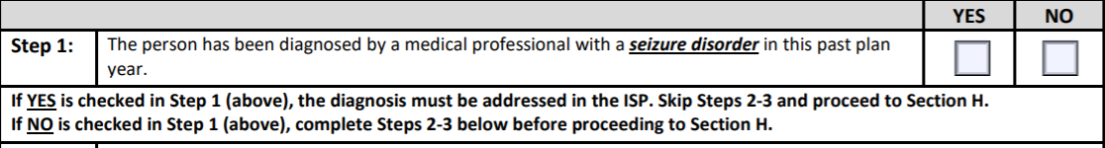
Follow these steps to success…
Prior to ISP meeting, review discharge summaries, medical reports, and health history for information.
Remember! Think about all settings: home, Day Support, Community Engagement
Skip Step 2 and go to Section H

Slide 20
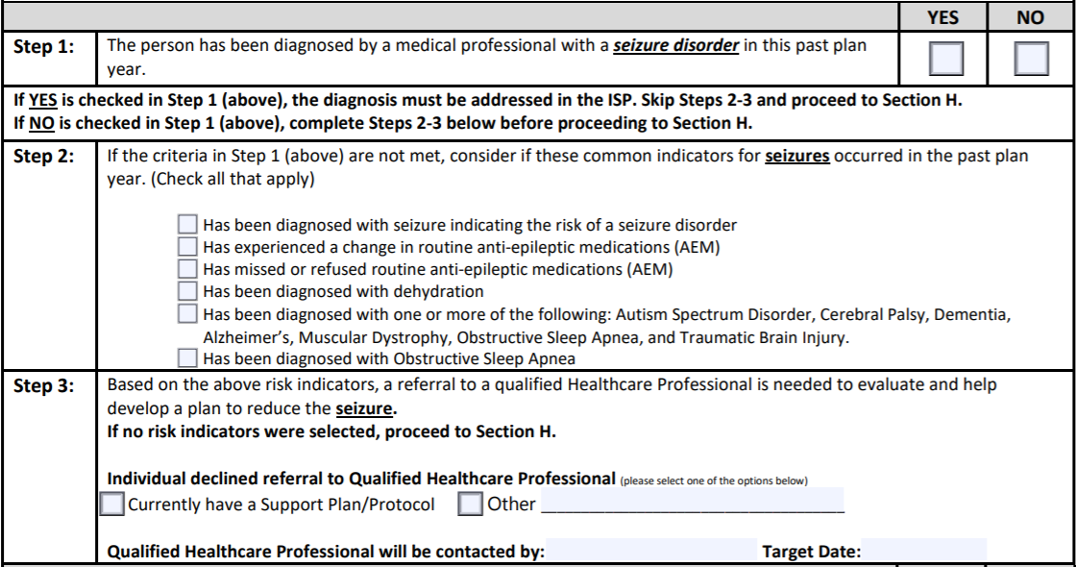
Follow these steps to success…
During the ISP meeting, ask all participants if they are aware of any risk factors noted in Step 2
Dr. Hopewell
Nov 15, 20

Slide 21
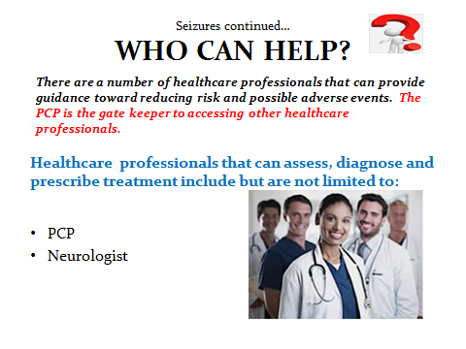

Slide 22
References
Abood, W. (2019). Seizure, Postictal State. Retrieved from https://www.ncbi.nlm.nih.gov/books/NBK526004/
Bonnett, L., Powell, G., Smith, C., & Marson, A. (2017). Risk of a seizure recurrence after a breakthrough seizure and the implications for driving: further analysis of the standard versus new antiepileptic drugs (SANAD) randomised controlled trial. BJM Open, 7(7). Retrieved from https://bmjopen.bmj.com/content/7/7/e015868.info.
Center for Disease Control and Prevention (2020). Seizure first aid. Retrieved from https://www.cdc.gov/epilepsy/about/first-aid.htm.
Center for Disease Control and Prevention (2018). Types of seizures. Retrieved from https://www.cdc.gov/epilepsy/about/types-of-seizures.htm
Devinsky, O., Asato, M., Camfield, P., Geller, E., Kanner, A. M., Keller, S., & Singh, B. K. (2015). Delivery of epilepsy care to adults with intellectual and developmental disabilities.Neurology,85(17), 1512-1521.
Dugan, P., Carlson, C., Bluvstein, J., Chong, D. J., Friedman, D., & Kirsch, H. E. (2014). Auras in generalized epilepsy. Neurology, 83(16), 1444-1449. doi:10.1212/wnl.0000000000000877
Karceski, S. C. (2007). Seizure medications and their side effects. Retrieved from https://n.neurology.org/content/69/22/e27
Mayo Clinic (2019). Seizures. Retrieved from https://www.mayoclinic.org/diseases-conditions/seizure/symptoms-causes/syc-20365711
Mayo Clinic (2019). Seizures: Treatment. Retrieved from https://www.mayoclinic.org/diseases-conditions/seizure/diagnosis-treatment/drc-20365730
Scaramelli, A., Braga, P., Avellanal, A., Bogacz, A., Camejo, C., Rega, I., . . . Arciere, B. (2009). Prodromal symptoms in epileptic patients: Clinical characterization of the pre-ictal phase. Seizure, 18(4), 246-250. doi:10.1016/j.seizure.2008.10.007
U.S. Department of Health and Human Services. National Institutes of Health (NIH) ( 2020.). Epilepsy – overview. Retrieved from https://medlineplus.gov/ency/article/000694.htm

