Slide 1

Sepsis
Risk Awareness Tool (RAT)
Presented by:
The Virginia Department of Behavioral Health and Developmental Services
The Office of Integrated Health
Health Supports Network

Slide 2
Who benefits from this training?
DSP's and caregivers- you will learn important risk factors associated with sepsis, learn to recognize signs and symptoms, and how to report and document.
Support Coordinators-you will learn important risk factors associated with sepsis, understand the signs and symptoms that DSP's and caregivers are going to recognize and provide in documentation, and learn diagnosis that may be associated with risk factors.

Slide 3
Objectives
1. State the definition of sepsis.
2. State (3) risk factors for sepsis.
3. Identify (4) signs and symptoms of sepsis.
4. Name a test used by physicians to
diagnose sepsis.
5. State (2) complications from sepsis.
6. State why reporting change is important.
7. Identify (3) measures to prevent sepsis.

Slide 4
Terms and definitions
Bacteremia-infection in the bloodstream
Electrolytes-are minerals in the body that have an electric
UTI- refers to a urinary tract infection.
Dialysis- A process where a machine performs the normal function of the kidneys by filtering harmful wastes, salt, and excess water from the blood.
Ventilator-A machine that supports breathing.
Septicemia- infection enters the bloodstream, another term for sepsis
Organ failure- when organs cannot perform their function and other parts of the body are affected.

Slide 5

What is sepsis?
Sepsis occurs when there is untreated infection present in the body. The extreme reaction can be life threatening. Infections that are often at the root of the cause are UTI’s, pressure injuries, respiratory infections (pneumonia). Medical conditions that complicate sepsis further are chronic kidney disease, cancer, diabetes, lung disease, cirrhosis, and HIV (Mayo Clinic, 2018).
According to the CDC, 1.7 million adults in the U.S. each year develop sepsis.
270,000 people die each year from sepsis
1 out of 3 people who die in the hospital have sepsis
(CDC, 2020)

Slide 6
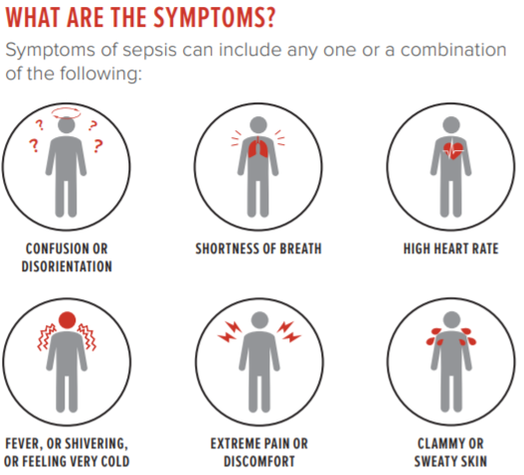
Signs and Symptoms
Confusion
Short of breath
Increased heart rate
Blood Pressure Systolic less than 100mm Hg
Fever
Shivering
Feeling cold
Extreme Pain
Discomfort
Clammy, sweaty skin
Decreased urine output
Skin rash
(Mayo Clinic, 2018) and
(Johns Hopkins, n.d.)
(CDC, 2019)

Slide 7

Risk factors for Sepsis
People 65years and older
Chronic conditions such as diabetes, cancer, kidney disease, lung disease, bacteremia
Weak immune system
Diabetes
Cirrhosis
Already in the ICU/very sick (Intensive Care Unit)
Children younger than 1yr old
Wounds, injuries, or burns
Organ transplants
Invasive devices presents (catheters, breathing tubes)
Has previously received antibiotics and/or corticosteroids
(Mayo Clinic, 2018)

Slide 8
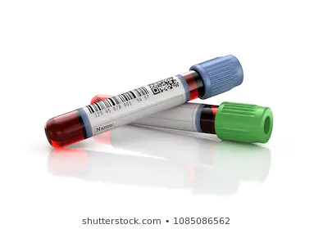
Diagnosing Sepsis
IMAGING:
X-ray: to check lungs for pneumonia.
CT Scan: infections in the pancreas and appendix are easier to visualize by CT.
Ultrasound: gallbladder and ovaries are easily identified.
MRI: identify infections in the soft tissues. (Mayo Clinic, 2018).
BLOOD TEST: look for the following information:
Infection-A high or low white blood cell count. A blood culture that is positive for infection.
Abnormal kidney or liver function.
Clotting issues. Low platelet count
Blood oxygen levels.
Electrolyte imbalances (Acidosis -too much acid in the blood).
OTHER:
Urinalysis- checks for bacteria in the urine.
Wound drainage- a culture of drainage from open wounds to identify bacteria.
Respiratory mucus- a culture of mucus coughed up to identify bacteria.

Slide 9
Treatment
Antibiotics- will be started quickly. A broad-spectrum antibiotic will be administered until culture and sensitivity tests are complete to identify bacteria. Antibiotic may be changed or an additional medication added once tests are complete.
IV fluids- increase blood volume and urine output, keep fluids circulating to vital organs
Vasopressors-constricts blood vessels and increases blood pressure
Corticosteroids-reduces inflammation and triggers tissue repair
Insulin- helps to control blood sugar levels
Pain relief- pain, discomfort, and fever
Sedatives- if a ventilator is required
(Johns Hopkins, n.d) (Mayo Clinic, 2018)

Slide 10
Complications of Sepsis
Septic shock-Toxins released by the bacteria in the bloodstream can cause extremely low blood flow, serious drop in blood pressure which may result in organ or tissue damage
Acute respiratory distress syndrome (ARDS). ARDS is a life-threatening condition that prevents adequate oxygen from reaching the lungs and blood. ARDS can result in permanent lung damage and may result the person being placed on a ventilator to assist with breathing
Kidney failure (May require dialysis)
Tissue death (gangrene) of fingers or toes that may require amputation. Small blood clots can form throughout your body. The clots block the flow of blood and oxygen to vital organs and other parts of the body. The clots can increase the risk of organ failure and tissue death
Permanent brain damage, which can cause memory problems or more severe symptoms
Endocarditis- Damage to the heart valves which can lead to heart failure.
Death- due to multiple organ failure.
Post-sepsis syndrome-consistent cognitive, psychological, physical, and medical defects following severe sepsis(Mostel, et al., 2019).
(O'Connell & Cafasso,2018) (Hotchkiss, et al., 2016)

Slide 11
Prevention
Taking steps to prevent the spread of infection can reduce the risk of developing sepsis.
Receiving vaccinations annually. Receiving vaccinations for flu, pneumonia, and other infections.
Encourage good hygiene. Proper wound care, handwashing, and bathing regularly.
Sustain mobility to reduce weakness and prevent pressure injury.
Maintaining sufficient nutritional status.
Obtaining immediate care when signs of infection are recognized. The sooner treatment is received, the better the outcome.
(O'Connell, 2018)

Slide 12

Importance of reporting change
Sepsis is life threatening. The quicker symptoms are recognized the better! Individuals with intellectual and developmental disabilities are at a disadvantage due to limited communication skills and inability to report pain. Using behavior changes as an indicator for pain when individuals are unable to report is an acceptable approach (Herr et al., 2006).
Respiratory infections and UTI's are common among individuals with intellectual and developmental disabilities. These individuals are at higher risk for septicemia and would benefit from preventive measures and early recognition (Ailey, Johnson, Fogg, & Friese, (2014).
Any changes or recognition that an individual has signs and symptoms on sepsis should be reported immediately. The individual should be taken to their PCP, Urgent Care, or ER if issue is found on a weekend. Document your findings in daily note and who it was reported to.

Slide 13
DSP's connect the dots....
Situation: Edward has been seen at Urgent Care twice this year for UTI’s. He requires prompting to drink and wash his hands. He uses hand mouthing as a coping mechanism. Yesterday Edward participated well. Today Edward is not drinking even with encouragement. He seems warm to touch, is frowning, and his urine was dark and had an odor at the last brief change.
Example of a daily note: Edward was showing signs of a possible UTI today. He refused to drink and felt warm to touch, Temp 99.6. His urine was very dark and has an odor. DSP notified the Manager and was instructed to take him to Urgent Care. Urgent Care instructed that he be taken to the ER. He was admitted with Sepsis.
Way to go DSP, you recognized a change!
Example only: follow your agency documentation standards.

Slide 14
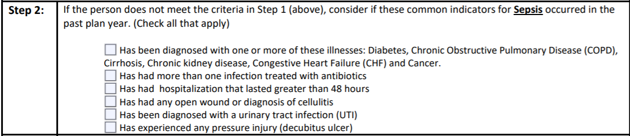
DSP's connect the dots....
You are the boots on the ground! Based on your daily observations you may recognize a change in status that would require evaluation. If you notice any of the risk factors listed below for sepsis, report and document it quickly.
Use the RAT tool to help staff be aware of risks and prompts changes within plans and support instructions. The RAT can help providers be proactive.

Slide 15
Case Study
Larry resides in a group home. Larry is the first to awake in the home every morning anxious to receive his morning coffee. Larry refers to everyone as friend and loves to set on the patio to greet everyone coming and going. Larry has CHF (congestive heart failure) and COPD (chronic obstructive pulmonary disease). Larry just finished an antibiotic a week ago for a lung infection. Larry awoke one morning and voiced "I just don't feel good". Larry was having a hard time ambulating due to his feet and ankles swelling. Larry resided in his recliner most of the day with his feet up,but did not rest well due to a persistant cough. Larry did not finish his morning cup of coffee and refused his lunch. Larry complains he is cold. Larry request to go to his room and lie down. When staff assist him to his room, they notice Larry's skin is sweaty and he is breathing harder than normal.

Slide 16


Apply what you’ve learned
What are three (3) interventions that could be utilized to help Larry.
1. ____________________________
2. ____________________________
3. ____________________________

Slide 17
Connect the dots with the RAT Tool...
SC's- as you are completing the RAT tool keep in mind there are key diagnoses and situations you need to incorporate in discussion with providers and caregivers to ensure risk factors are being recognized.
Individual is non-verbal, cannot express pain
Individual is prone to have urinary tract infections
Individual has asthma, COPD, emphysema
Individual is incontinent and has frequent skin breakdown
Individual's that are
immunocompromised or have received
long-term antibiotic therapy and have developed antibiotic resistance. ​
RAT TOOL
Individual's that have a previous medical DX of sepsis.
Look for infections caused by Staph, E.Coli, Streptococcus
Sepsis can be the result of bacterial, fungal, or viral infections

Slide 18
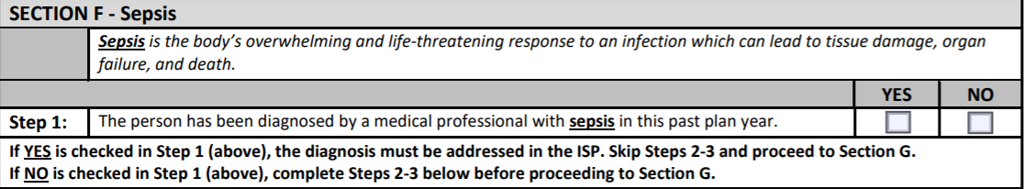
Follow these steps to success…
Prior to ISP meeting, review discharge summaries, medical reports, and health history for information.
Remember! Think about all settings: home, Day Support, Community Engagement
Skip Step 2 and go to Section G

Slide 19
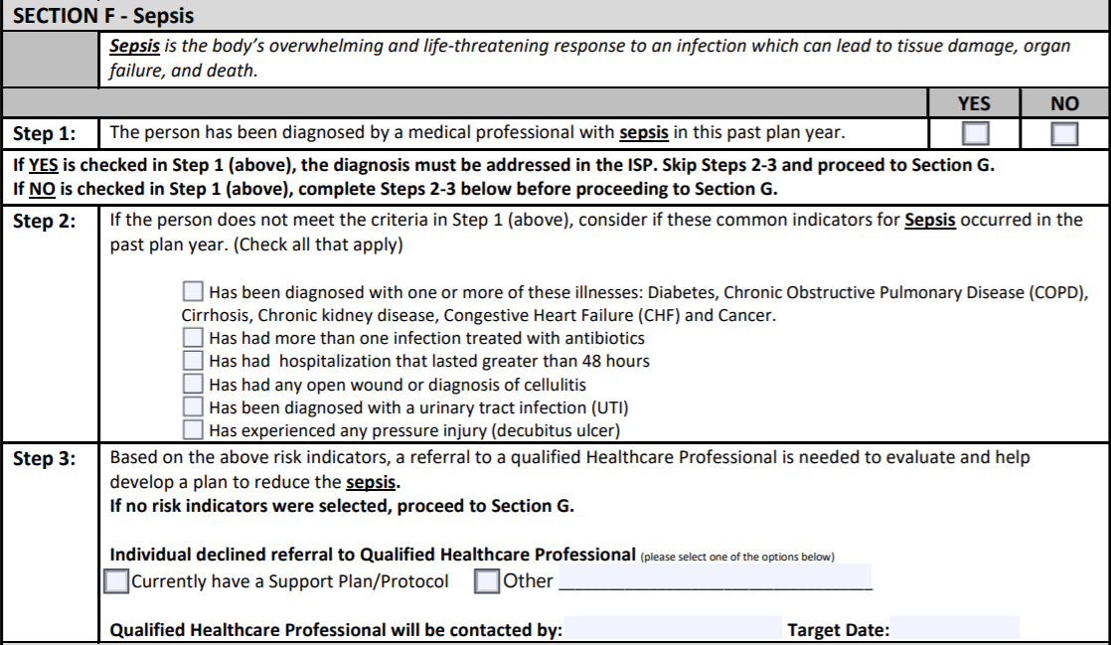
Follow these steps to success…
During the ISP meeting ask all participants if they are aware of any risk factors listed in Step 2
Dr. Hopewell
Nov 15, 20

Slide 20
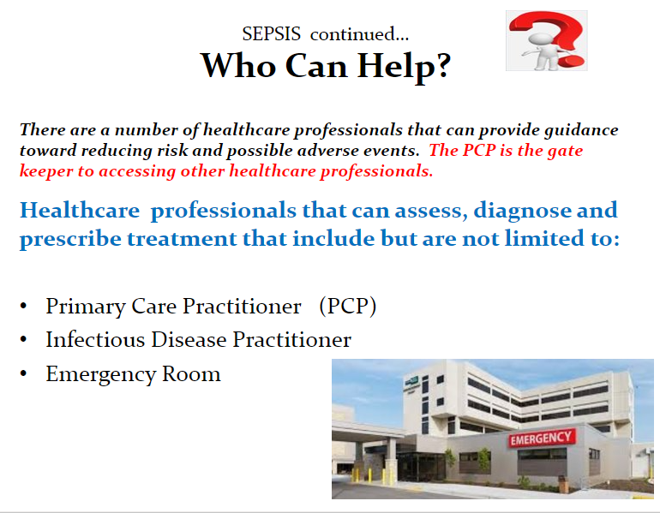

Slide 21
References
Ailey, S., Johnson, T., Fogg, L., & Friese, T. (2014). Hospitalizations of adults with intellectual and developmental disability in academic medical centers. Intellectual and developmental disability, 52(3),187-192. Doi: 10.1352/1934-9556-52.3.187
Center for Disease Control and Prevention (CDC). (2019). What is sepsis? Retrieved from https://www.cdc.gov/sepsis/what-is-sepsis.html
Center for Disease Control and Prevention (CDC). (2016). Making healthcare safer. Think Sepsis. Time Matters. Retrieved from https://www.cdc.gov/vitalsigns/pdf/2016-08-vitalsigns.pdf
Center for Disease Control and Prevention (CDC). (2020). Data & Reporting: Sepsis. Retrieved from https://www.cdc.gov/sepsis/datareports/index.html
Clevland Clinic.(n.d.). Sepsis Diagnosis and Tests. Retrieved from https://my.clevelandclinic.org/health/diseases/12361-sepsis/diagnosis-and-tests
Herr, K., Coyne, P., Key, T., Manworren, R., McCaffery, M., Merkel, S., Kelly, J., & Wild, L. (2006). Pain assessment in the non-verbal patient: Position statement with clinical practice recommendations. Pain Management Nursing, 7(2), 44-52.
Hotchkiss, R., Moldawer, L., Opal, S., Reinhart, K., Turnbull, I., & Vincent, J. L. (2016). Sepsis and septic shock. Nature reviews. Disease primers, 2, 16045. https://doi.org/10.1038/nrdp.2016.45
Johns Hopkins. (n.d). Sepsis. Retrieved from https://www.hopkinsmedicine.org/health/conditions-and-diseases/sepsis
Mayo Clinic (2018). Sepsis: Risk Factors. Retrieved from https://www.mayoclinic.org/diseases-conditions/sepsis/symptoms-causes/syc-20351214
Mayo Clinic. (2018). Sepsis: Overview. Retrieved from https://www.mayoclinic.org/diseases-conditions/sepsis/symptoms-causes/syc-20351214
Mostel, Z., Perl, A., Marck, M., Mehdi, S. F., Lowell, B., Bathija, S., … Roth, J. (2019). Post-sepsis syndrome – an evolving entity that afflicts survivors of sepsis. Molecular Medicine, 26(1). doi: 10.1186/s10020-019-0132-z
O'Connell ,K., (2018). Sepsis. Retrieved from https://www.healthline.com/health/sepsis
O'Connell , K., & Cafasso, J. (2018). Septicemia. Retrieved from https://www.healthline.com/health/septicemia

Slide 22
Resources
Printable Posters from the CDC: https://www.cdc.gov/sepsis/education/patient-resources.html
Sepsis Alliance Fact Sheet: file:///C:/Users/dbk75942/Downloads/Sepsis-FactSheet-v2-4.pdf
Sepsis Alliance https://www.sepsis.org/

